Slide 1
Windows Forms

Slide 2
Vienkāršākais Windows lietojums
using System.Windows.Forms;
class HelloForm
{
public static void Main()
{
Form form = new Form();
form.Text = "Hello!";
Application.Run(form);
}
}

Slide 3
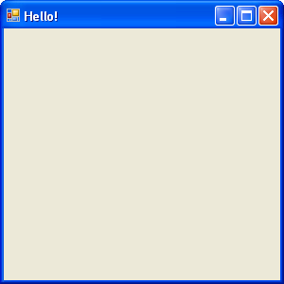
Vienkāršākais Windows lietojums

Slide 4
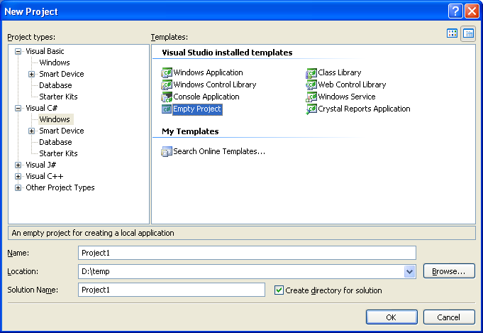
Projekta izveide
(File -> New Project)

Slide 5
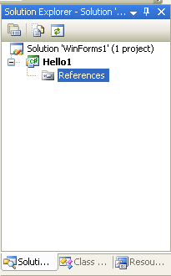
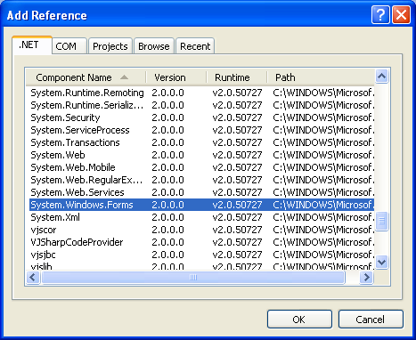
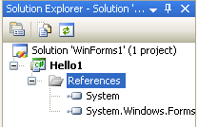
Norādes pievienošana projektam
(Project -> Add Reference)

Slide 6
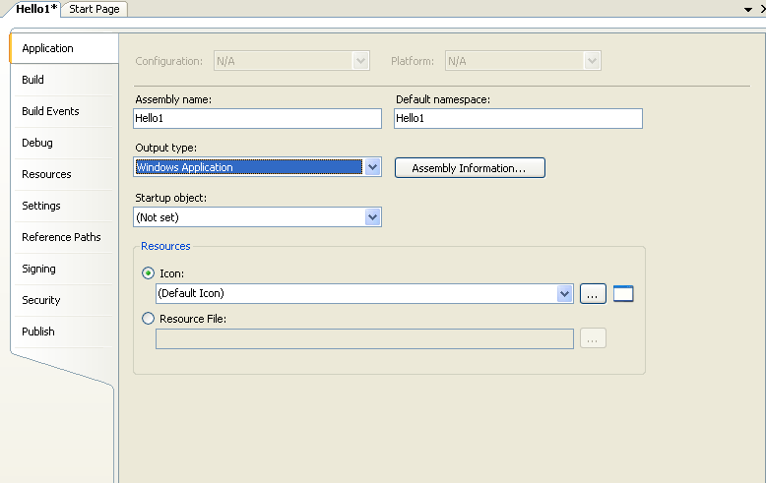
Projekta parametri
(Project -> Properties)

Slide 7
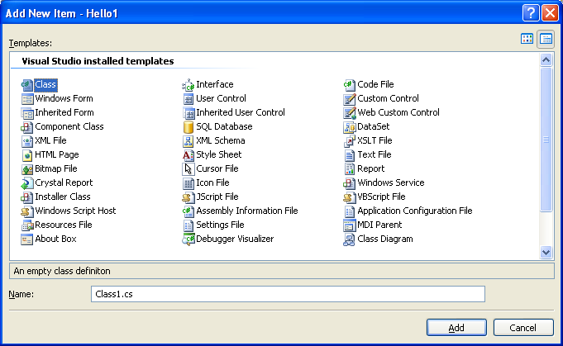
Pirmskoda pievienošana
(Project -> Add New Item)

Slide 8
Vienkāršākais Windows lietojums
using System;
using System.Drawing;
using System.Windows.Forms;
class InheritForm : Form
{
public static void Main()
{
Application.Run(new InheritForm());
}
public InheritForm()
{
Text = "Inherit with constructor";
BackColor = Color.White;
}
}

Slide 9
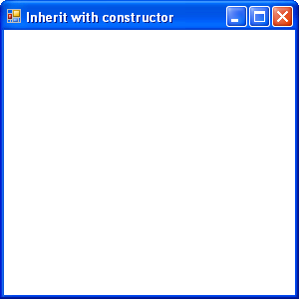
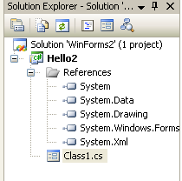
Vienkāršākais Windows lietojums
using System.Drawing;

Slide 10
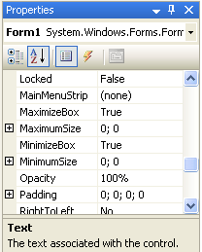
Formas
(Project -> Add Windows Form)
Name
AcceptButton
CancelButton
FomBorderStyle
Text
Opacity
Size
Height
Width

Slide 11
Formu īpašības
NewForm.Size = new System.Drawing.Size(250,250);
NewForm.Height = 250;
NewForm.Location = new Point(250,250);
NewForm.Location.x = 250;
NewForm.Location.Right = 250;

Slide 12
Formu īpašības
MinimumSize
MaximumSize
TopMost
WindowState
Parent

Slide 13
Formu metodes
Close
Show
Hide
ShowDialog
Invalidate

Slide 14
Modālie logi
Form2 ModDialog = new Form2();
ModDialog.ShowDialog();
if (ModDialog.DialogResult==DialogResult.OK)
MessageBox.Show("Processing request");
else
if (ModDialog.DialogResult==DialogResult.Cancel)
MessageBox.Show("Cancelling request");
ModDialog.Dispose();

Slide 15
Īpašība ParentForm
class DialogaLogs : Form
{
private void ParentInfo()
{ string data =
((MyForm)this.ParentForm).GetPInfo();
} ...
}
class MyForm : Form
{
...
public string GetPInfo() { ... }
}

Slide 16
void ButtonOkOnClick(
object obj, EventArgs ea)
{
...
Dialog.Result = DialogResult.OK;
}
...
btn.Click += new EventHandler(ButtonOkOnClick);

Slide 17
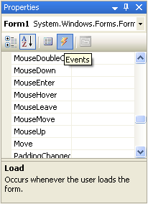
Formas notikumi
Load
Activated
Deactivate
FormClosing
FormClosed
Paint
Resize
Move

Slide 18
using System;
using System.Drawing;
using System.Windows.Forms;
class PaintEvent
{
public static void Main()
{
Form form = new Form();
form.Text = "Paint Event";
form.Paint += new
PaintEventHandler(MyPaintHandler);
Application.Run(form);
}
static void MyPaintHandler(
object objSender, PaintEventArgs pea)
{
Graphics grfx = pea.Graphics;
grfx.Clear(Color.Chocolate);
}
}

Slide 19
Notikuma Paint delegāts
public delegate void PaintEventHandler(
object objSender,
PaintEventArgs pea);
form.Paint += new PaintEventHandler(MyPaintHandler);
static void MyPaintHandler(
object objSender,
PaintEventArgs pea) { ... }

Slide 20
Klase PaintEventArgs
ClipRectangle
Graphics
Graphics grfx = pea.Graphics;
grfx.Clear(Color.Chocolate);

Slide 21
using System;
using System.Drawing;
using System.Windows.Forms;
class HelloWorld : Form
{
public static void Main()
{
Application.Run(new HelloWorld());
}
public HelloWorld()
{
Text = "Hello World";
BackColor = Color.White;
}
protected override void
OnPaint(PaintEventArgs pea)
{
Graphics grfx = pea.Graphics;
grfx.DrawString("Hello!", Font,
Brushes.Black, 0, 0);
}
}

